Slide 1
Summary of research work with Goldwind
2/1/2019-11/15/2019
Prepared by Nitesh Kumar
Texas A&M University

Slide 2
Power curve and performance analysis
Two main methodologies:
Power curve modeling
Turbine to turbine comparison
Two case analyses:
Time-wise comparison
Space-wise comparison

Slide 3
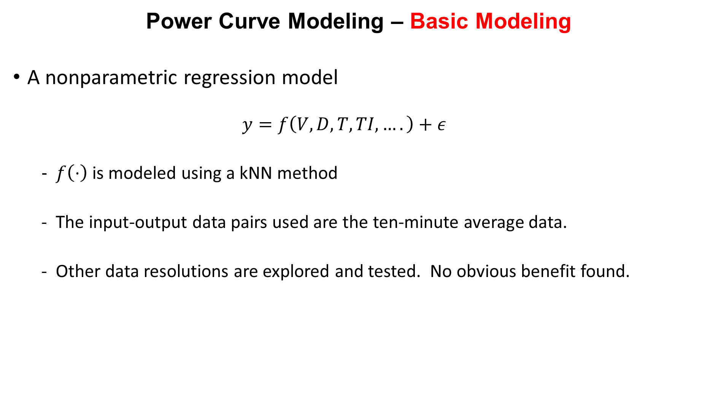
Power Curve Modeling – Basic Modeling
A nonparametric regression model
$$y=f\left(V, D, T, TI, ….\right)+ε$$
$f\left(⋅\right)$ is modeled using a kNN method
The input-output data pairs used are the ten-minute average data.
Other data resolutions are explored and tested. No obvious benefit found.

Slide 4
Power Curve Modeling – Inputs Selection
Which input variables are important?
Conducted a data mining of the original dataset for exploring which variables are potentially relevant.
Many variables in the datasets bear relevance but they are endogenous to the turbine, like rotor speed (G) or pitch angles.
Narrow down to a list of about 9 variables
[W, D, Time, TI, Temp, SdD, WLag1, WLag2, delta]
Find that generally only [W, Temp, TI] are important enough, but [D, SdD] are still used to control the comparability environmental conditions.

Slide 5
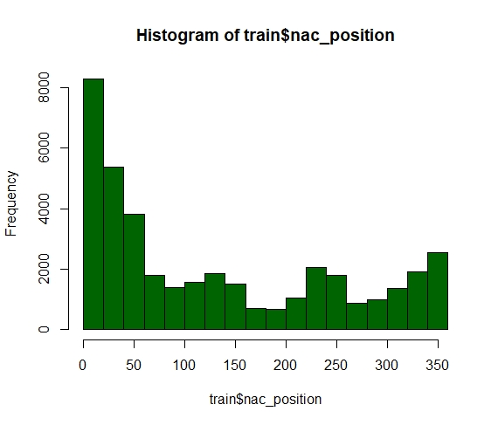
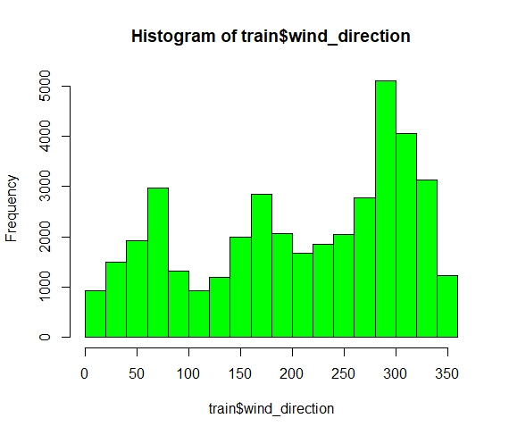
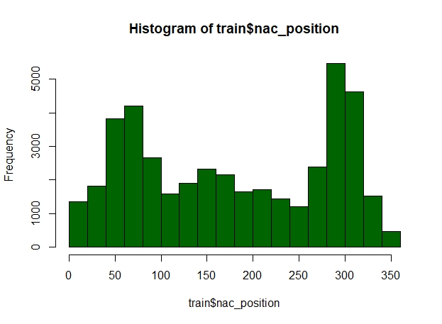
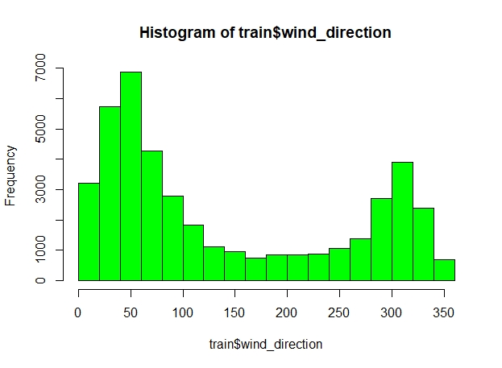
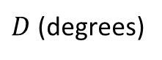
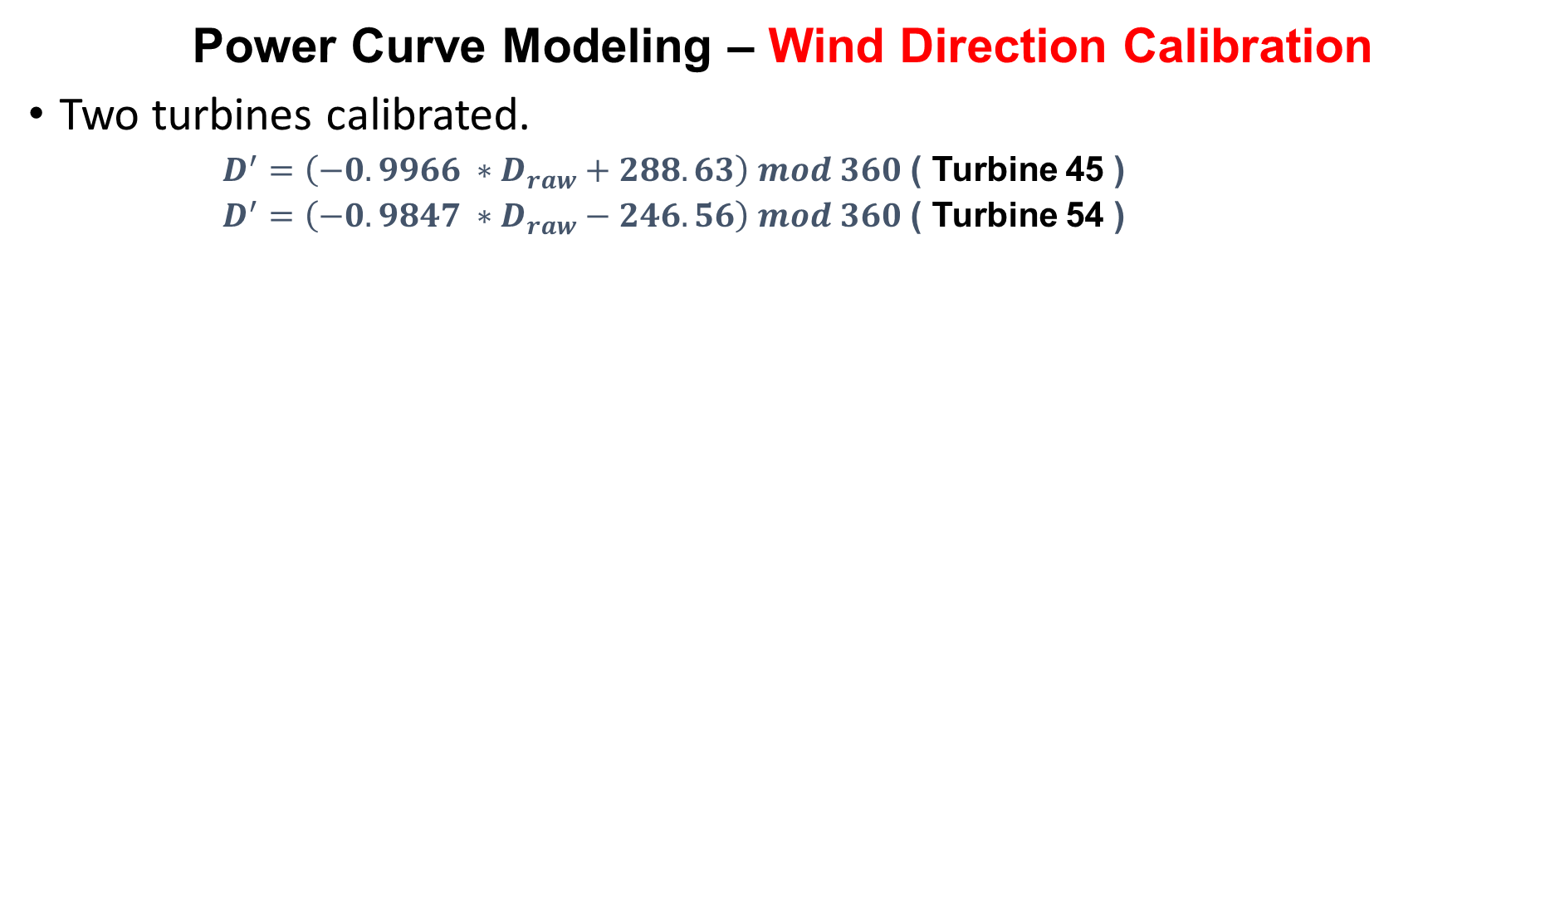
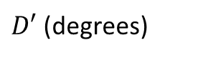
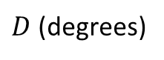
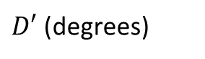
Power Curve Modeling – Wind Direction Calibration
Two turbines calibrated.
$D^{′}=\left(−0.9966 ∗D_{raw}+288.63\right) mod 360$ ( Turbine 45 )
$D^{′}=\left(−0.9847 ∗D_{raw}−246.56\right) mod 360$ ( Turbine 54 )
$D$ (degrees)
$D′$ (degrees)
Frequency
Turbine # 45
Frequency
$D$ (degrees)
$D′$ (degrees)
Frequency
Turbine # 54
Frequency

Slide 6
Power Curve Modeling – Model Selection After Calibration
Turbine #45
Turbine #54
Number of predictor | Variables | RMSE | Error w.r.t rated power
1 | W | 61.35 | 4.09 %
2 | W+T | 43.25 | 2.88 %
2 | W+D | 55.97 | 3.73 %
2 | W+TI | 58.42 | 3.89 %
3 | W+T+D | 43.63 | 2.90 %
3 | W+T+TI | 42.06 | 2.80 %
4 | W+T+TI+D | 46.24 | 3.08 %
Number of predictor | Variables | RMSE | Error w.r.t rated power
1 | W | 46.38 | 3.09 %
2 | W+T | 36.16 | 2.41 %
2 | W+D | 44.61 | 2.97 %
2 | W+TI | 43.18 | 2.87 %
3 | W+T+D | 37.28 | 2.48 %
3 | W+T+TI | 35.54 | 2.36 %
4 | W+T+TI+D | 40.74 | 2.71 %
It appears that the wind direction misalignment is biased by a constant.
The calibrated wind direction still does not appear to be more important than the three previously identified important variables [W, Temp (i.e., T), TI].

Slide 7
Turbine-to-Turbine Comparison
The key is to control for the environmental conditions, so that they are comparable.
A two-step procedure.
Variable matching, in a probabilistic sense, as the initial step to select comparable environmental conditions. Three variables are used: W, Temp, TI.
A Gaussian process (GP) model to control for two most important variables (W and Temp).

Slide 8
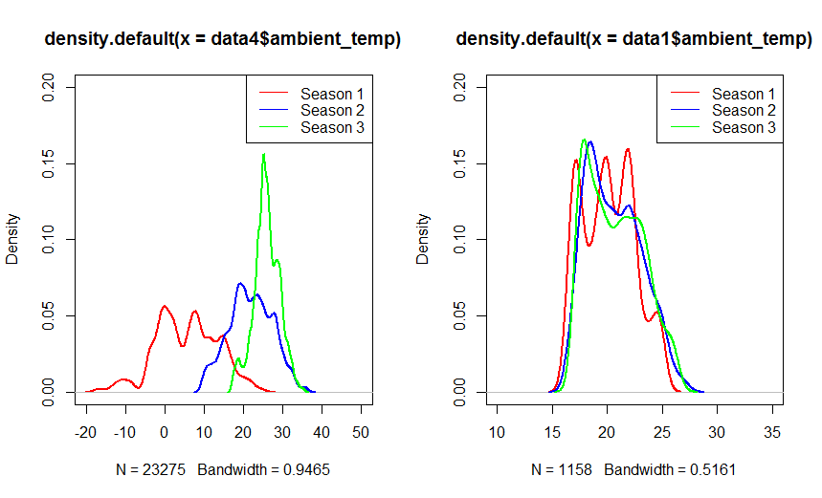
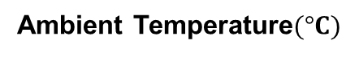
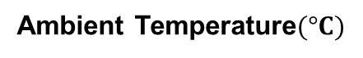
Turbine-to-Turbine Comparison – Variable Matching
Before matching
After matching
Ambient Temperature$(°C)$
Ambient Temperature$(°C)$
Use the temperature variable as an example here but the concept/method extends to other environmental variables too.

Slide 9
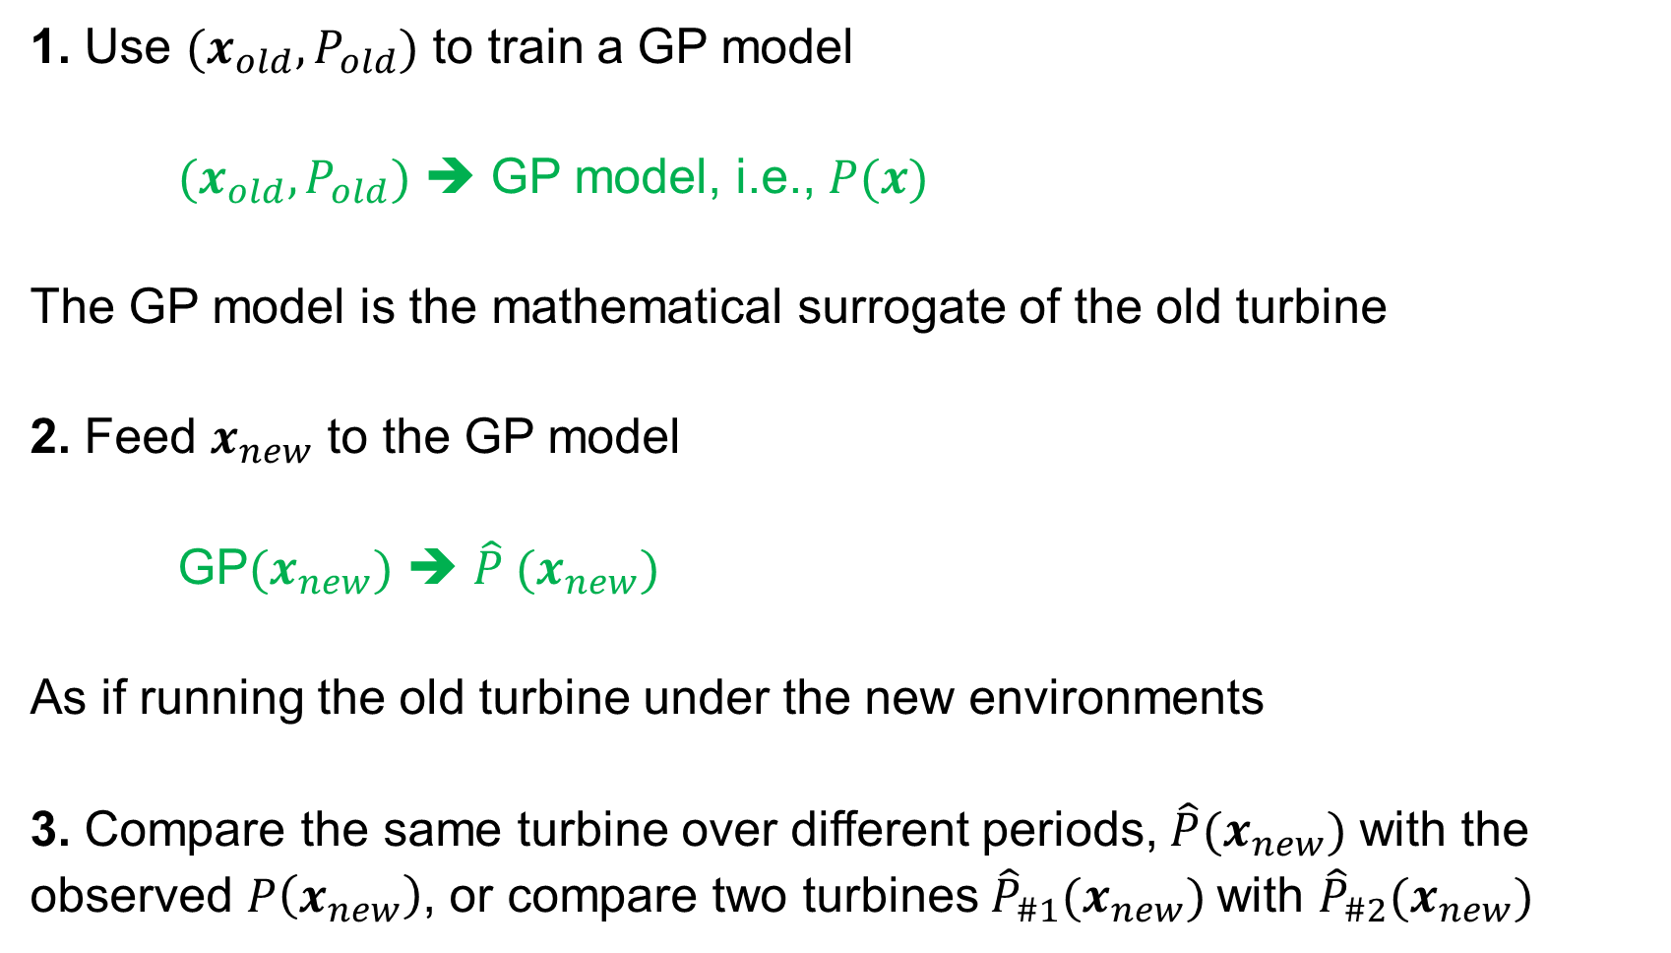
Turbine-to-Turbine Comparison – GP Model for Additional Control
1. Use $(x_{old}, P_{old})$ to train a GP model
$(x_{old}, P_{old})$ ➔ GP model, i.e., $P(x)$
The GP model is the mathematical surrogate of the old turbine
2. Feed $x_{new}$ to the GP model
GP$(x_{new})$ ➔ $\hat{P} (x_{new})$
As if running the old turbine under the new environments
3. Compare the same turbine over different periods, $\hat{P}(x_{new})$ with the observed $P\left(x_{new}\right)$, or compare two turbines${\hat{P}}_{\#1}(x_{new})$ with ${\hat{P}}_{\#2}(x_{new})$

Slide 10
Turbine-to-Turbine Comparison – Quantify the Difference
The differences between the two turbines are quantified by
Unweighted power production difference
The unweighted power difference is when each testing environmental condition is treated as happening in the equal frequency.
Weighted power production difference
The weighted power difference is when actual relative frequencies of the testing environmental conditions are used to weigh the power production difference.

Slide 11
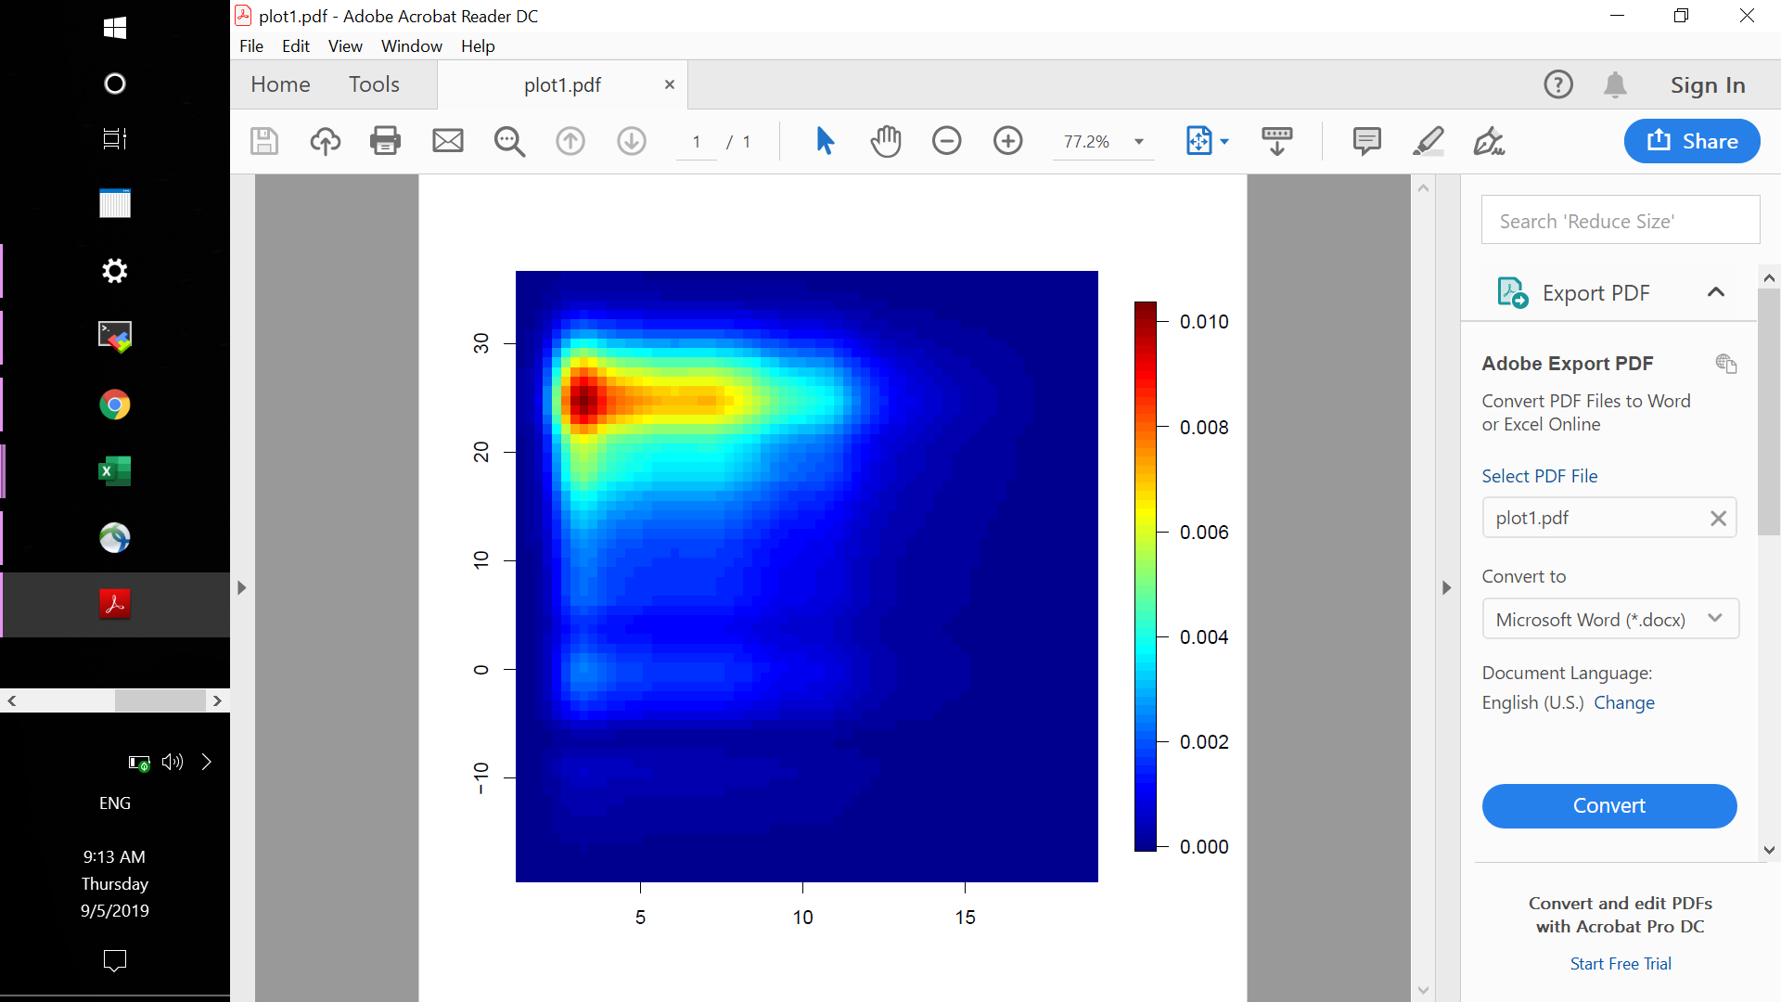

Turbine-to-Turbine Comparison – Environmental Condition Probability
Probability density
Ambient temperature $(°C)$
Increasing probability
Wind speed ( m/s )

Slide 12
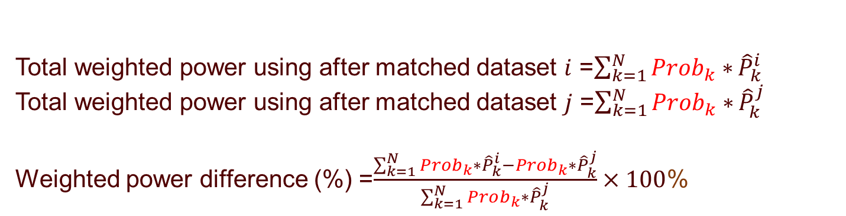
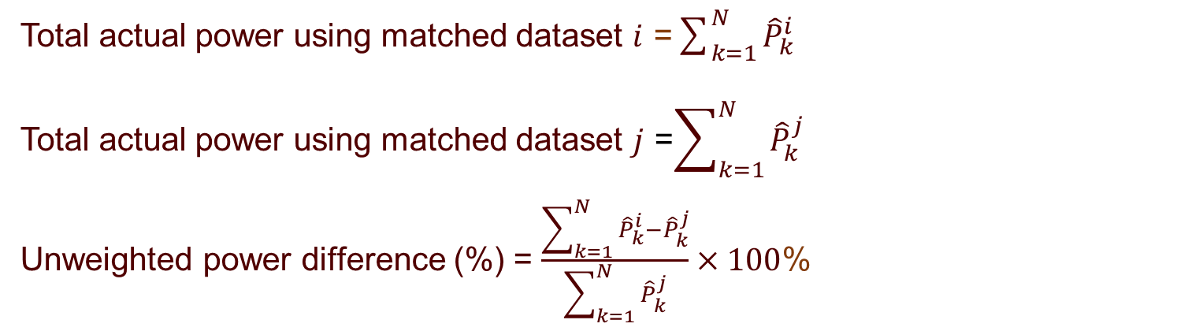
Turbine-to-Turbine Comparison – Formula
Unweighted power production difference
Weighted power production difference
Total actual power using matched dataset $i$ =$\sum_{k=1}^{N}{{\hat{P}}_{k}^{i}}$
Total actual power using matched dataset $j$ =$\sum_{k=1}^{N}{{\hat{P}}_{k}^{j}}$
Unweighted power difference (%) = $\frac{\sum_{k=1}^{N}{{\hat{P}}_{k}^{i}−{\hat{P}}_{k}^{j}}}{\sum_{k=1}^{N}{{\hat{P}}_{k}^{j}}}×100$%
Total weighted power using after matched dataset $i$ =$\sum_{k=1}^{N}{Prob_{k}∗}{\hat{P}}_{k}^{i}$
Total weighted power using after matched dataset $j$ =$\sum_{k=1}^{N}{Prob_{k}∗}{\hat{P}}_{k}^{j}$
Weighted power difference (%) =$\frac{\sum_{k=1}^{N}{Prob_{k}∗{\hat{P}}_{k}^{i}}−Prob_{k}∗{\hat{P}}_{k}^{j}}{\sum_{k=1}^{N}{Prob_{k}∗{\hat{P}}_{k}^{j}}}×100$%

Slide 13
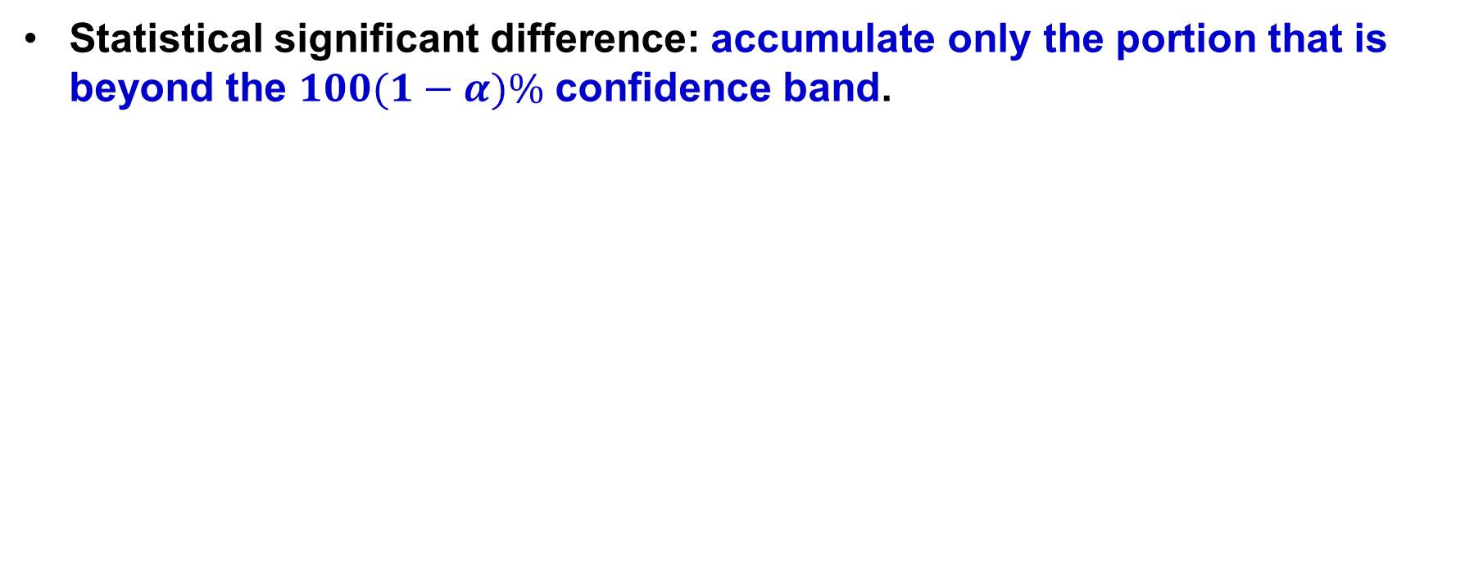
Turbine-to-Turbine Comparison – Statistical Significant Difference
Statistical significant difference: accumulate only the portion that is beyond the $100(1−α)\%$ confidence band.
95% confidence band
95% confidence band
Statistical significant difference
Statistical difference is smaller than the total difference
Statistical difference = 0

Slide 14
Time wise comparison – Timeline and Notations
[2-1]: Comparing V0+P1 to V0
[3-2]: Comparing V1+P1 to V0+P1
[4-3]: Comparing V1+P1 to V1+P2
Unweighted versus weighted
Percentage difference versus actual power difference
Statistical change: the change beyond 95% confidence interval.

Slide 15
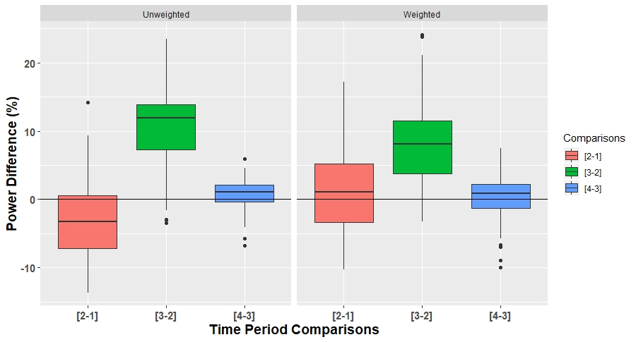
Time wise comparison – Total Difference in Percentage (%)
[2-1]: Effect of P1
[3-2]: Effect of V1
[4-3]: Effect of P2

Slide 16
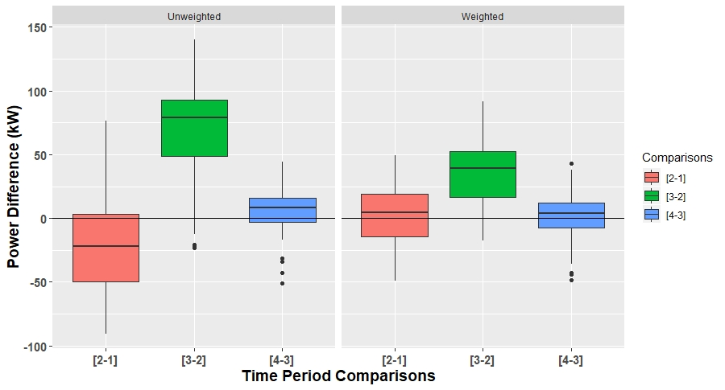
Time wise comparison – Total Difference in Actual Power (kW)
[2-1]: Effect of P1
[3-2]: Effect of V1
[4-3]: Effect of P2

Slide 17
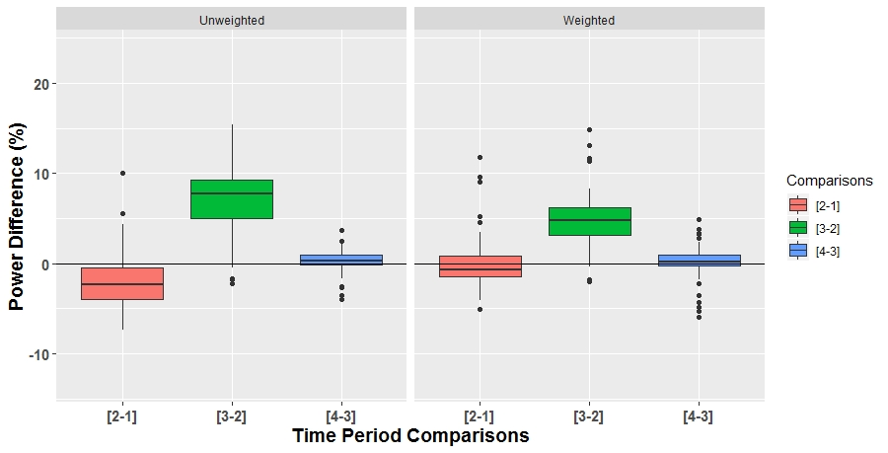
Time wise comparison – Statistical Difference in Percentage (%)
[2-1]: Effect of P1
[3-2]: Effect of V1
[4-3]: Effect of P2

Slide 18
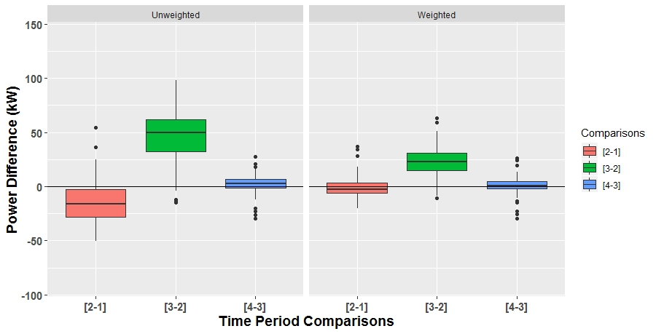
Time wise comparison – Statistical Difference in Actual Power (kW)
[2-1]: Effect of P1
[3-2]: Effect of V1
[4-3]: Effect of P2

Slide 19
Space wise comparison – Reference Turbine
Turbine #12 selected to be the reference turbine.

Slide 20
Space wise comparison – All Turbines Relative to #12 of Each Year
Legend
Blue circle: base turbine#12;
Green circle: turbine better than #12;
Red circle: turbine worse than #12;
Color intensity indicates the magnitude of the difference.

Slide 21
Space wise comparison – All Turbines Relative to #12 of 2015
Legend
Blue circle: base turbine#12;
Green circle: turbine better than #12;
Red circle: turbine worse than #12;
Color intensity indicates the magnitude of the difference.

Slide 22
Difference Time Partition-All Turbines Relative to #12 of Period 1
Legend
Blue circle: base turbine#12;
Green circle: turbine better than #12;
Red circle: turbine worse than #12;
Color intensity indicates the magnitude of the difference.

